Slide 1



SOFTWARE DEVELOPMENT PROFESSIONAL PROGRAM
Conditional Statements

Slide 2





Conditional Statements
Learning Objectives
Identify when to use conditional statements.
Make conditional decisions using if-else statements.
Make conditional decisions using switch-case statements.

Slide 3

Conditional Statements
Conditions
Notes:
One of the things we learn as children is to check for cars before we cross the street.
*If* a car is coming, we wait.
*Else* (or, otherwise), it's safe to cross.

Slide 4

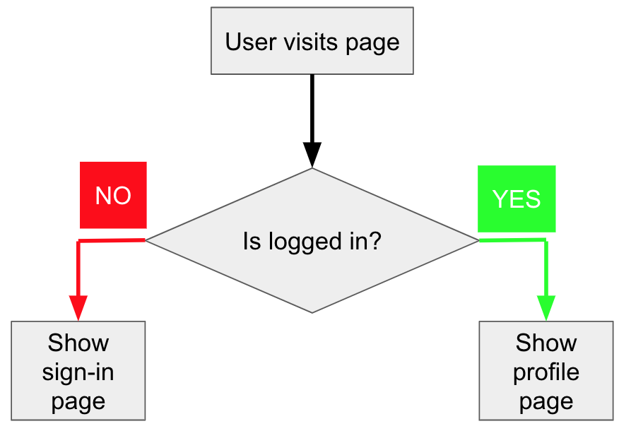
Conditional Statements
Conditions in Code
Notes:
We will need to teach our software to respond to similar true or false conditions.
<<Exercise 01--We use conditional statements to respond to a condition>>

Slide 5

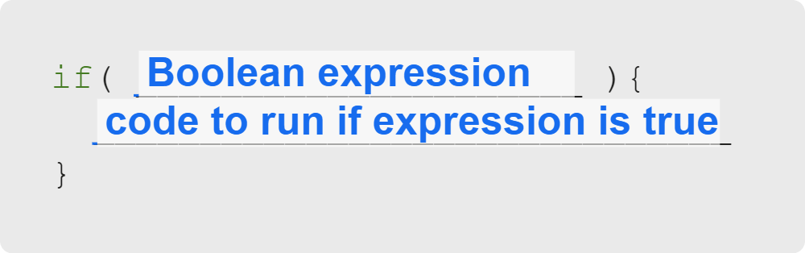
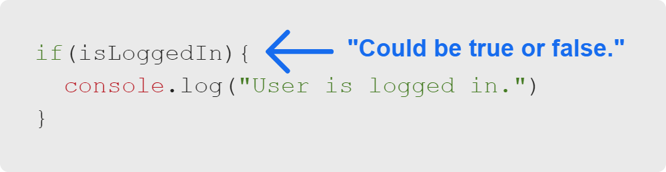
Conditional Statements
if Statement
General Example:
Possible Example:
Notes:
"if" statements let us create a block of code that ONLY runs when a Boolean expression is true.
There are three parts to this;
1. The 'if' keyword
2. The conditional statement in parenthesis
3. The block of code that runs if the conditional statement evaluates to true
<<Exercise 02--run a console log if a variable has a certain value>>

Slide 6
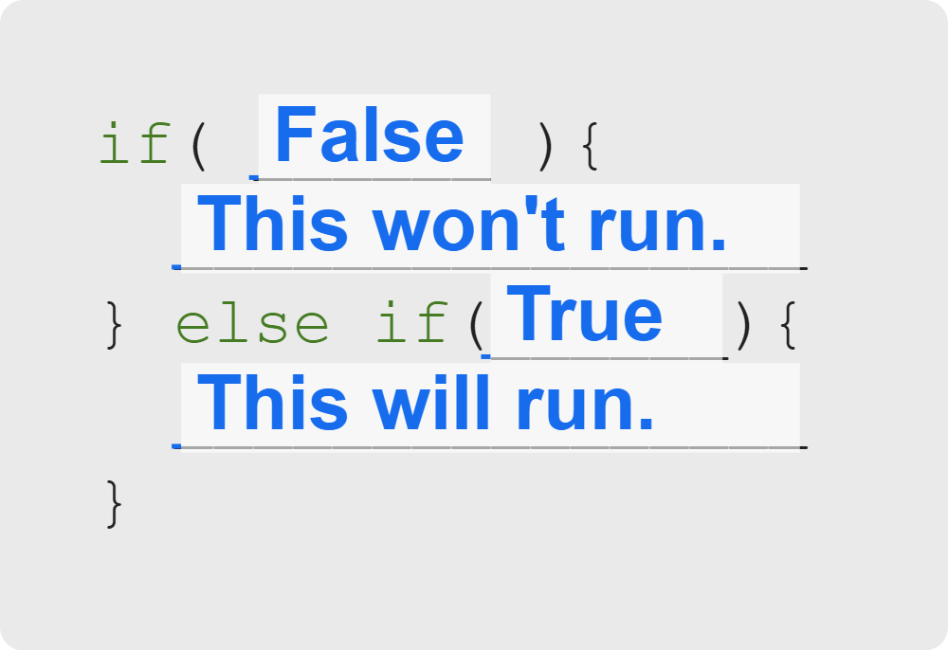
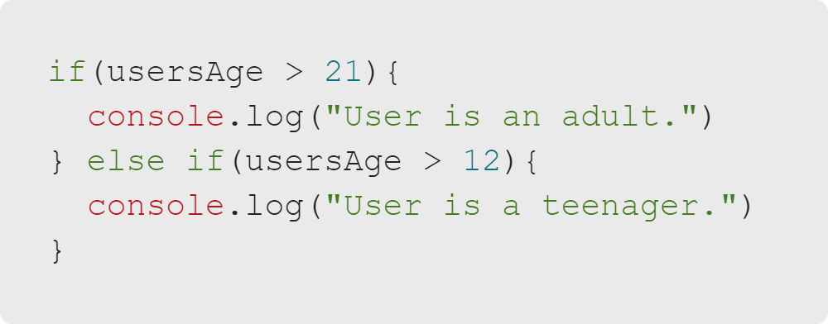
Conditional Statements
else if
General Example:
Possible Example:
Notes:
"else if" statements let us ask a follow-up question if the first
condition was false.
What if we changed the order of this conditional? Would the else if ever resolve?

Slide 7
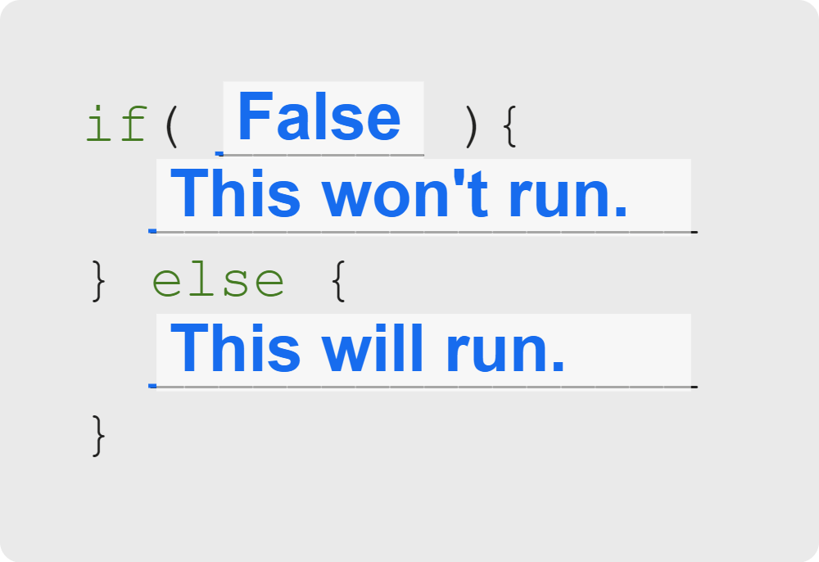
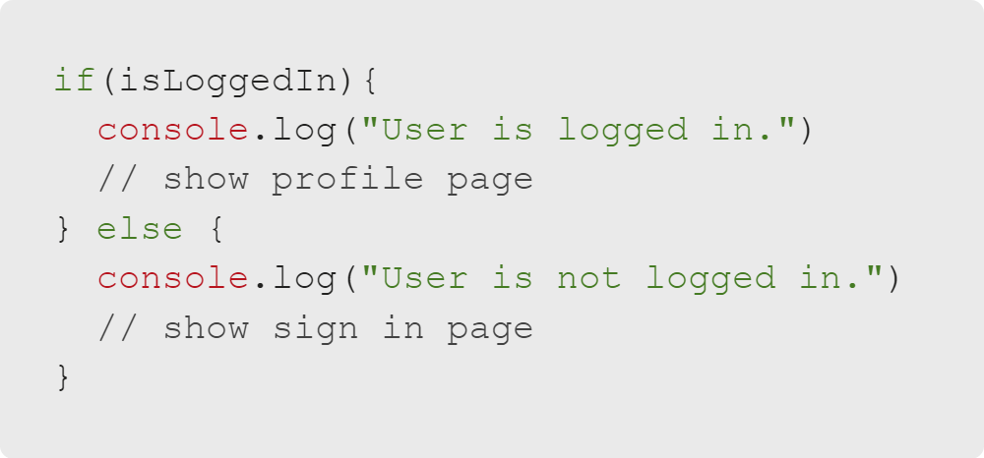
Conditional Statements
else
General Example:
Possible Example:
Notes:
"else" statements let us run code if all other conditions are false.
<<Exercise 3--console log different strings depending on if a variable has a certain value>>

Slide 8

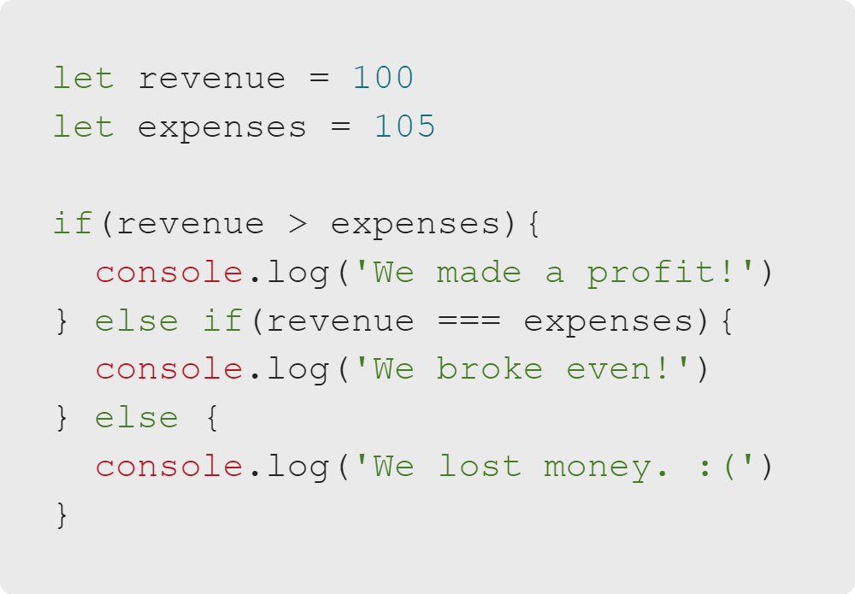
Conditional Statements
Quiz: Multiple Choice
What will be logged?
A. We made a profit!
B. We broke even!
C. We lost money. :(
D. Nothing

Slide 9
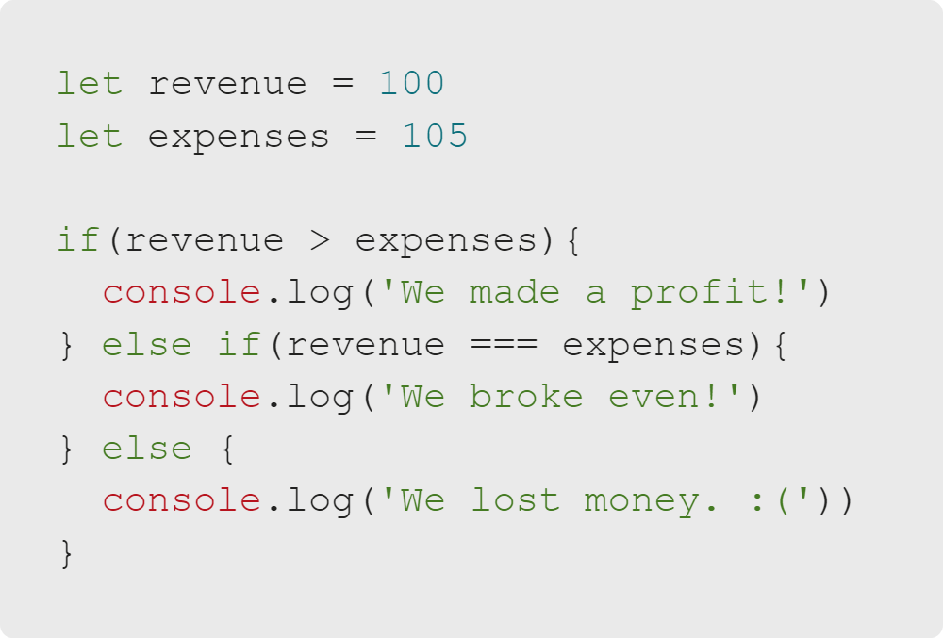
Conditional Statements
Quiz: Multiple Choice Answers
What will be logged?
🚫 We made a profit!
🚫 We broke even!
✅ C. We lost money. :(
🚫 Nothing

Slide 10
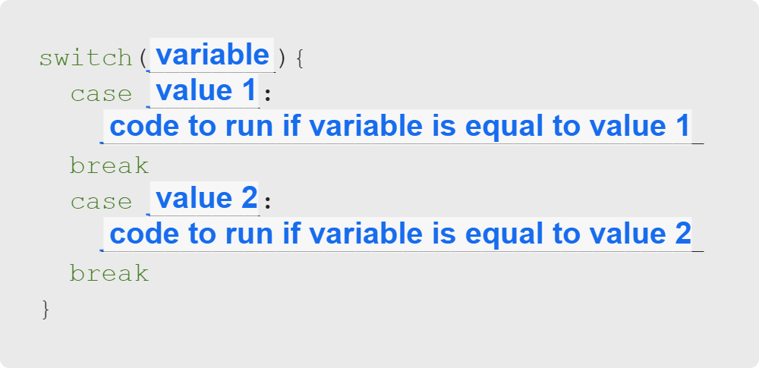
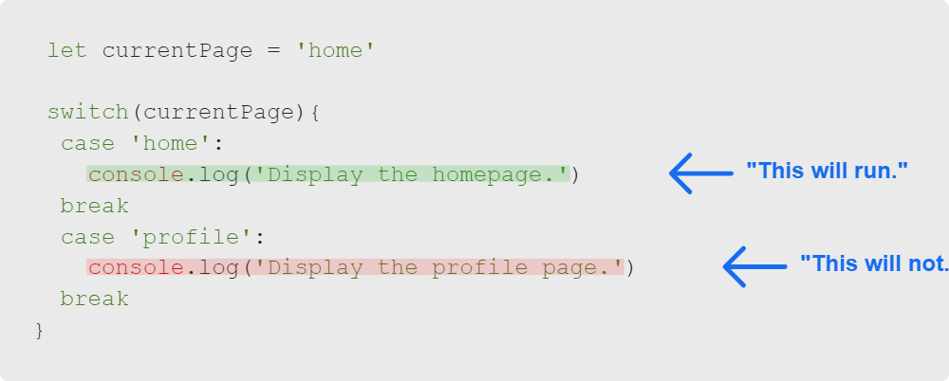
Conditional Statements
switch
General Example:
Possible Example:
Notes:
"switch" statements, like "if" statements, let us respond to conditions.

Slide 11
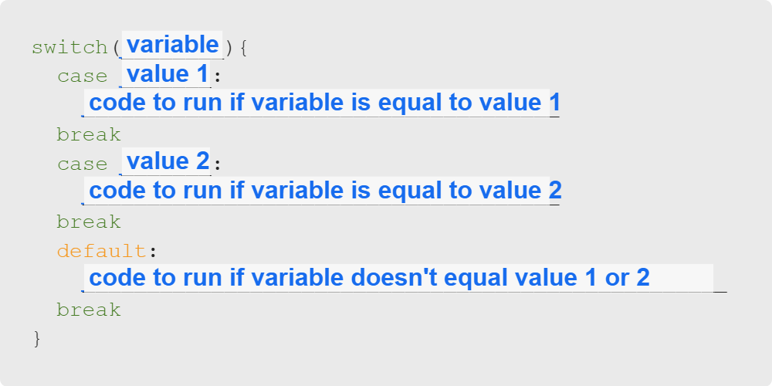
Conditional Statements
switch Default Case
Notes:
A default case runs when the the variable doesn't match any of the previous cases.
What is the equivalent in a standard if/else statement?
<<Exercise 4--use a switch statement to console log different strings depending on if a variable has a certain value.
Use of 'default' is implied in the question.>>

Slide 12
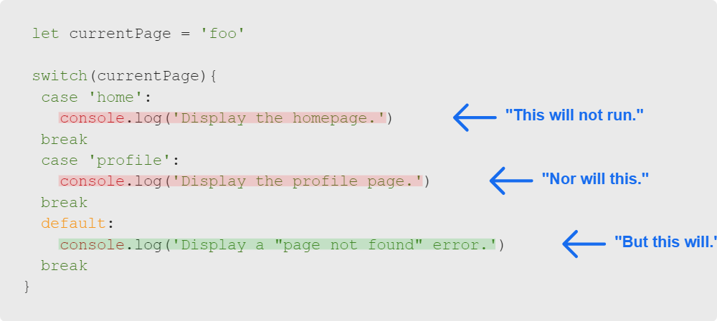
Conditional Statements
switch Default Case Example

Slide 13
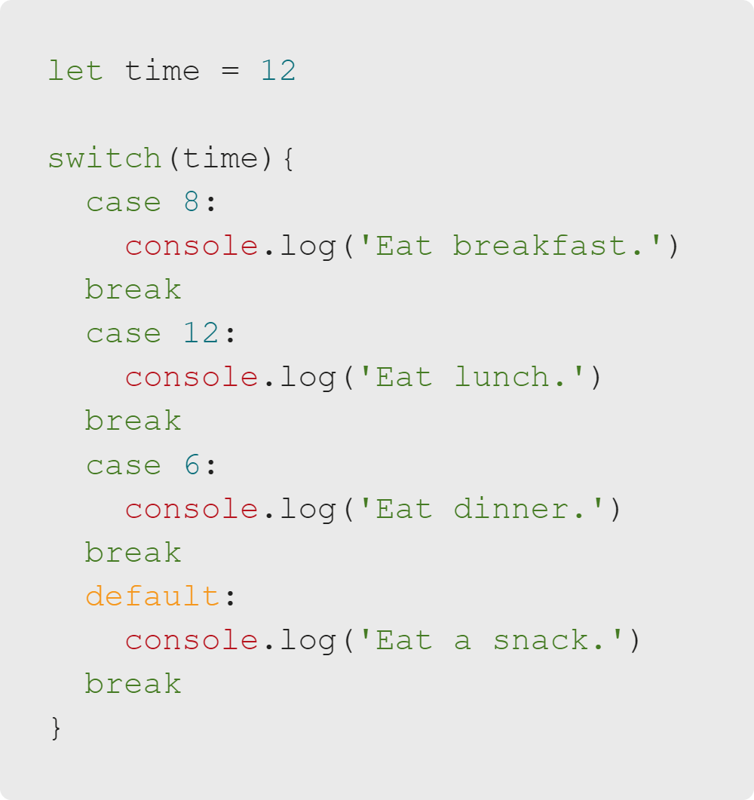
Conditional Statements
Quiz: Multiple Choice
What will be logged?
A. Eat breakfast.
B. Eat lunch.
C. Eat dinner.
D. Eat a snack.

Slide 14
Conditional Statements
Quiz: Multiple Choice Answers
What will be logged?
🚫 Eat breakfast.
✅ Eat lunch.
🚫 Eat dinner.
🚫 Eat a snack.

Slide 15
Conditional Statements
Summary
What We've Covered:
Conditional Statements
Conditions in Code
If Statements, Else If, and Else
Switch Statements
Switch Cases
Let's practice conditional statements by making a choose-your-own-adventure game!

